Slide 1
Lesson 2
Christ:
The Lord of His Church

Slide 2
Christ: The Lord of His Church
Acts 2:1-4
John 3:16
Acts 1:5-8
When the Holy Spirit came, the apostles were prepared to begin their work.

Slide 3
Christ: The Lord of His Church
Acts 2:36
How did Peter prove Jesus was Lord and Christ?
V. 22
Worked miracles
V. 24
God raised Him from the dead

Slide 4
Christ: The Lord of His Church
V. 27, 29-31
He fulfilled the prophecy from David that the Holy One would not see decay.
Of what did Peter accuse the crowd?
Crucifying their messiah

Slide 5
Christ: The Lord of His Church
What was the crowd’s response?
“What shall we do?”
Acts 2:38
Repent
Turn around
Be baptized
Be immersed in water

Slide 6
Christ: The Lord of His Church
Seem strange?
Purification rites of the Law
John the Baptist
46 pools for purification by the temple

Slide 7
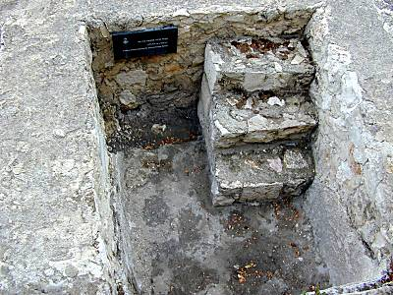
What does this look like?

Slide 8
Christ: The Lord of His Church
Could these 46 “baptisteries” have been where the 3,000 were baptized?
“In the name of Jesus Christ”
By His authority
Submit to Him
Jesus as Lord

Slide 9
Christ: The Lord of His Church
Why does Peter say they are to be baptized?
“For the forgiveness of your sins”
Other passages that teach this?
How many do what Peter asked?
3,000

Slide 10
Christ: The Lord of His Church
Acts 2:47
What happens daily?
More are being saved.
What does “added to them” mean?
A body of the saved to which more are being added.
What will this body be called later?

Slide 11
Christ: The Lord of His Church
Who does the adding?
The Lord
Is there a passage which calls the day of Pentecost “the beginning?”
Acts 11:15

Slide 12
Review
1. Who made Christ to be Lord?
God.
2. What did people on Pentecost do to show their belief in Christ?
“What shall we do?”
3. Who added them to the saved?
The Lord/God

Slide 13
Review
4. If we do what those on Pentecost did, will God add us to the same body of the saved?
Acts 2:39
Yes
5. Why is it important to see Pentecost as the beginning?
New Lord, new commands to obey

Slide 14
Review
6. What would one do today to be added to the same church?
Same thing they did.
Believe, repent, and be baptized

